Slide 1
NEO4J CYPHER TUTORIAL WITH PYTHON
Find the in degree Count for available Nodes within a graph|part:1
Tutorial 39

Slide 2
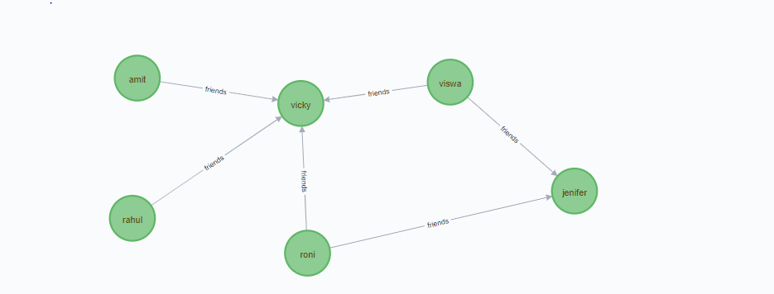
Find the number of incoming first degree connections for nodes within a Graph
Example graph

Slide 3
Find the number of incoming first degree connections for nodes (If available)within a Graph
What is the degree of a node
IN DEGREE FOR VICKY
OUT DEGREE FOR AMIT
OUT DEGREE VISWA
IN DEGREE FOR JENIFER
OUT DEGREE FOR RAHUL
OUT DEGREE FOR RONI

